Slide 1
Project 2
Darryl Bunn
Antonio Gomez
Robert Riggs
Jonathan Torres

Slide 2

Which locations see the highest traffic of sales..

Slide 3
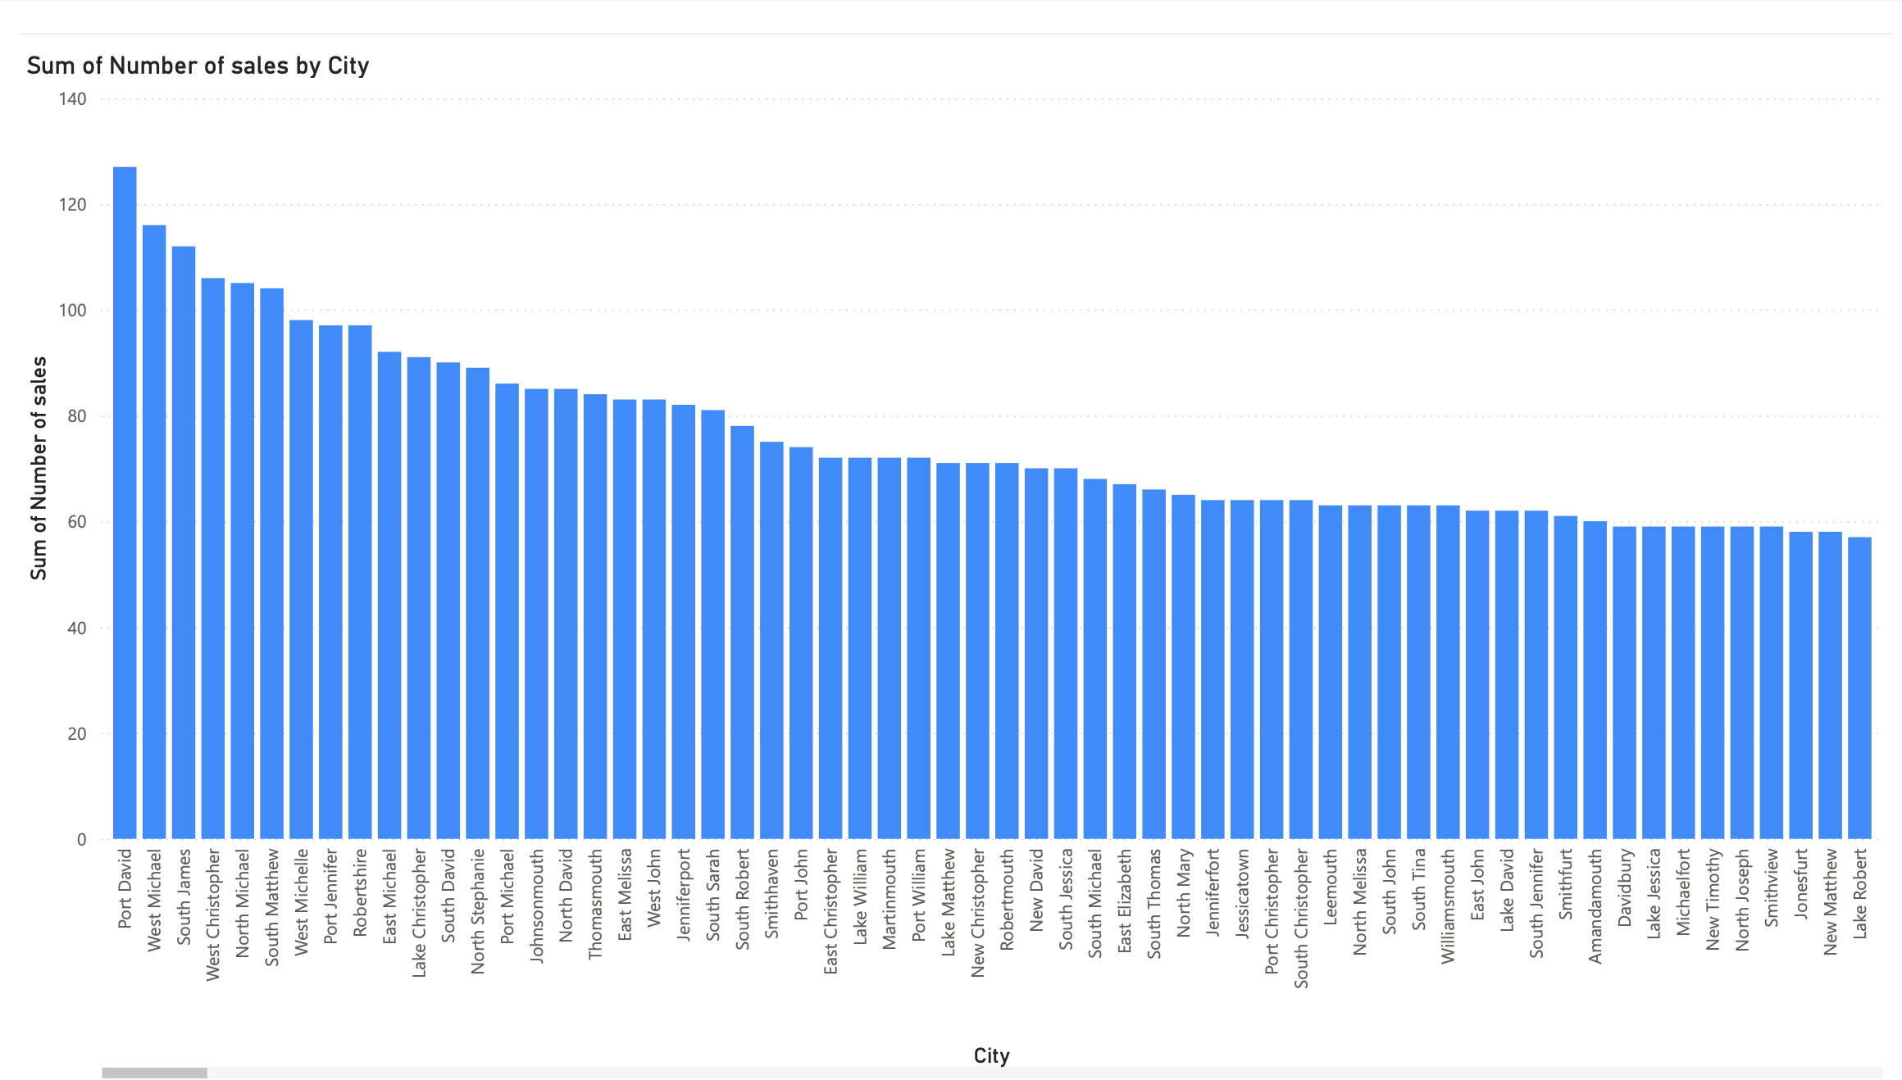
By City

Slide 4
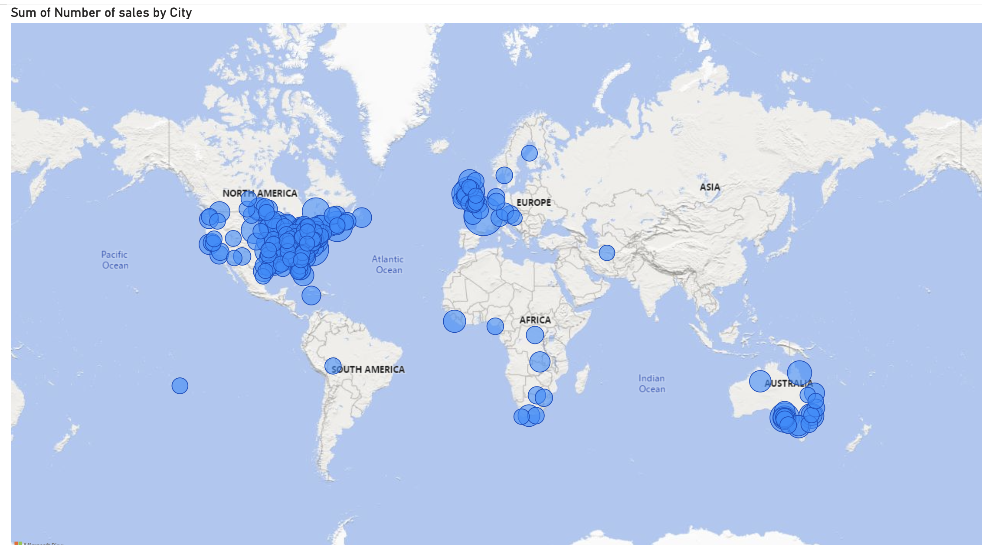

Slide 5
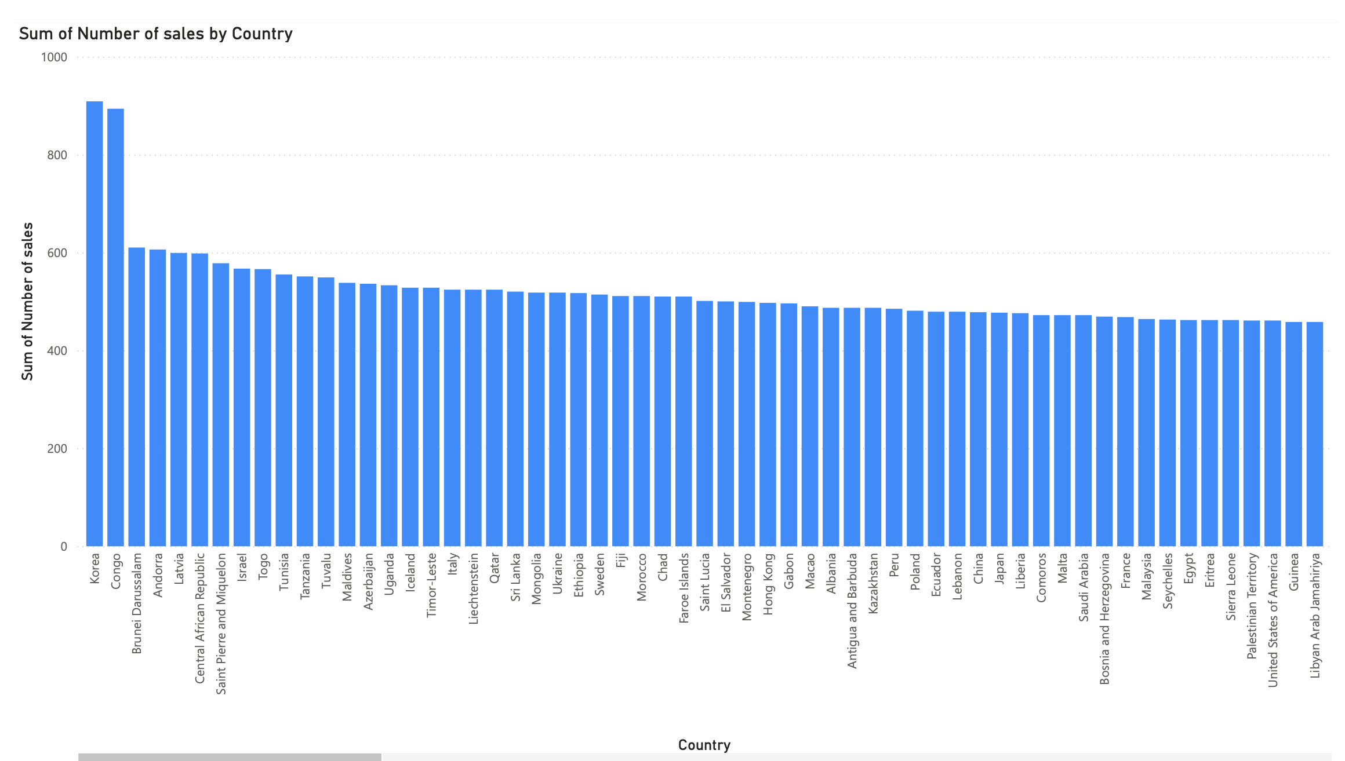
By country

Slide 6
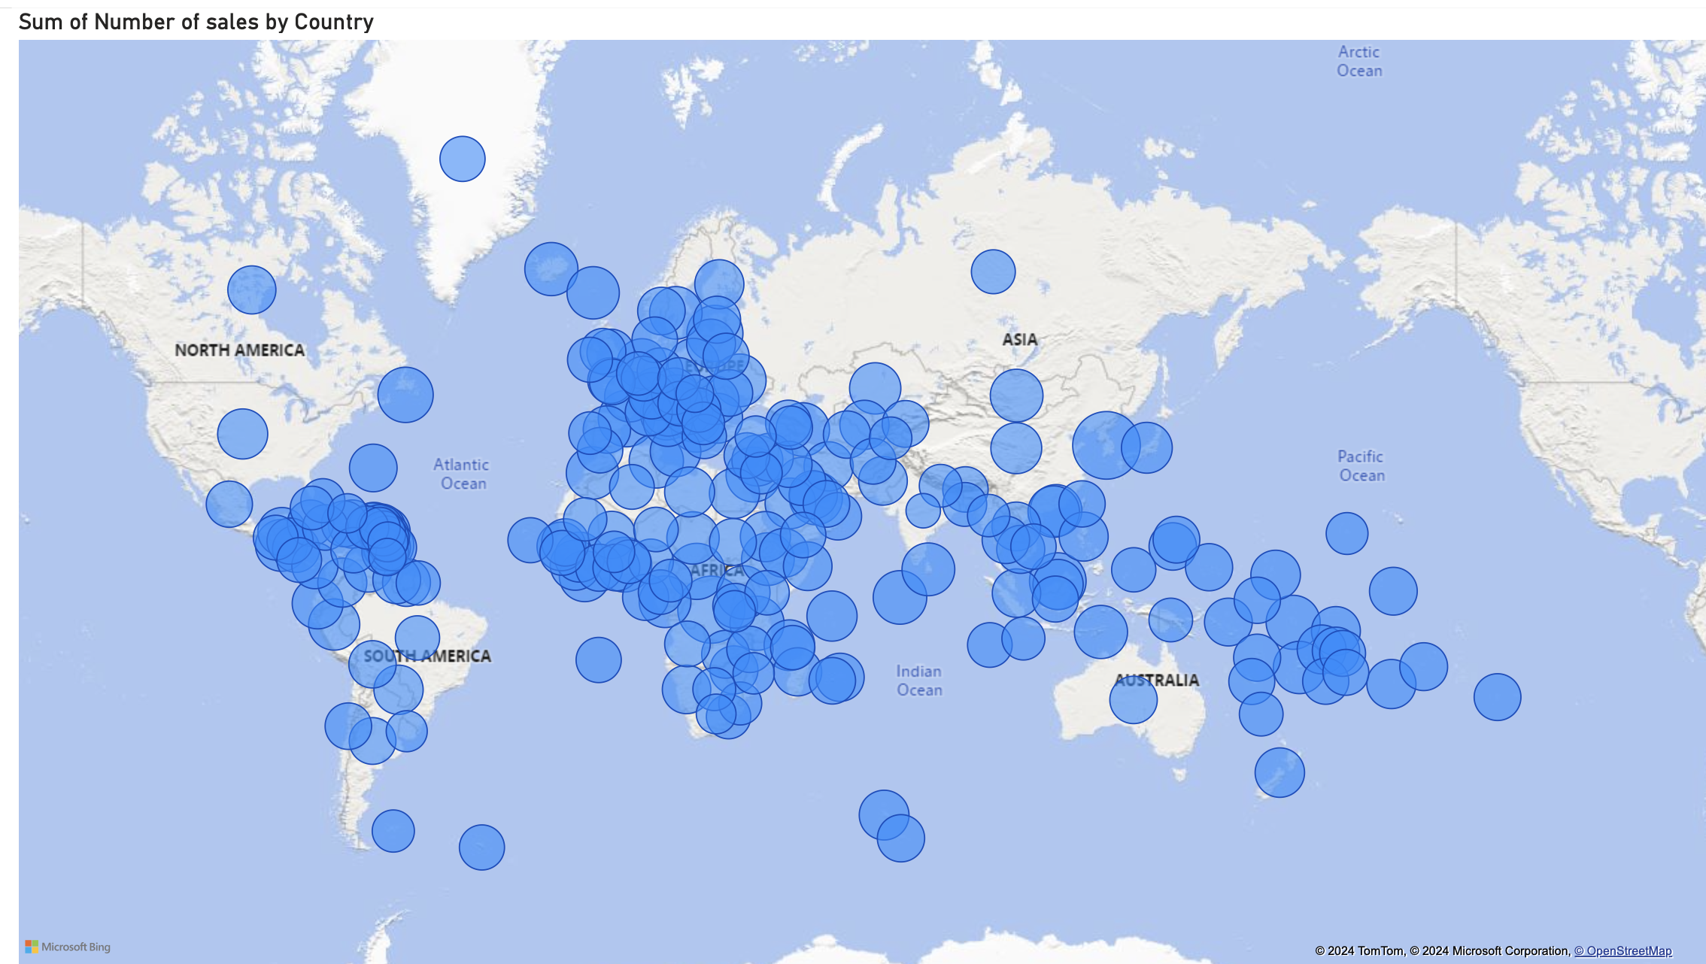

Slide 7
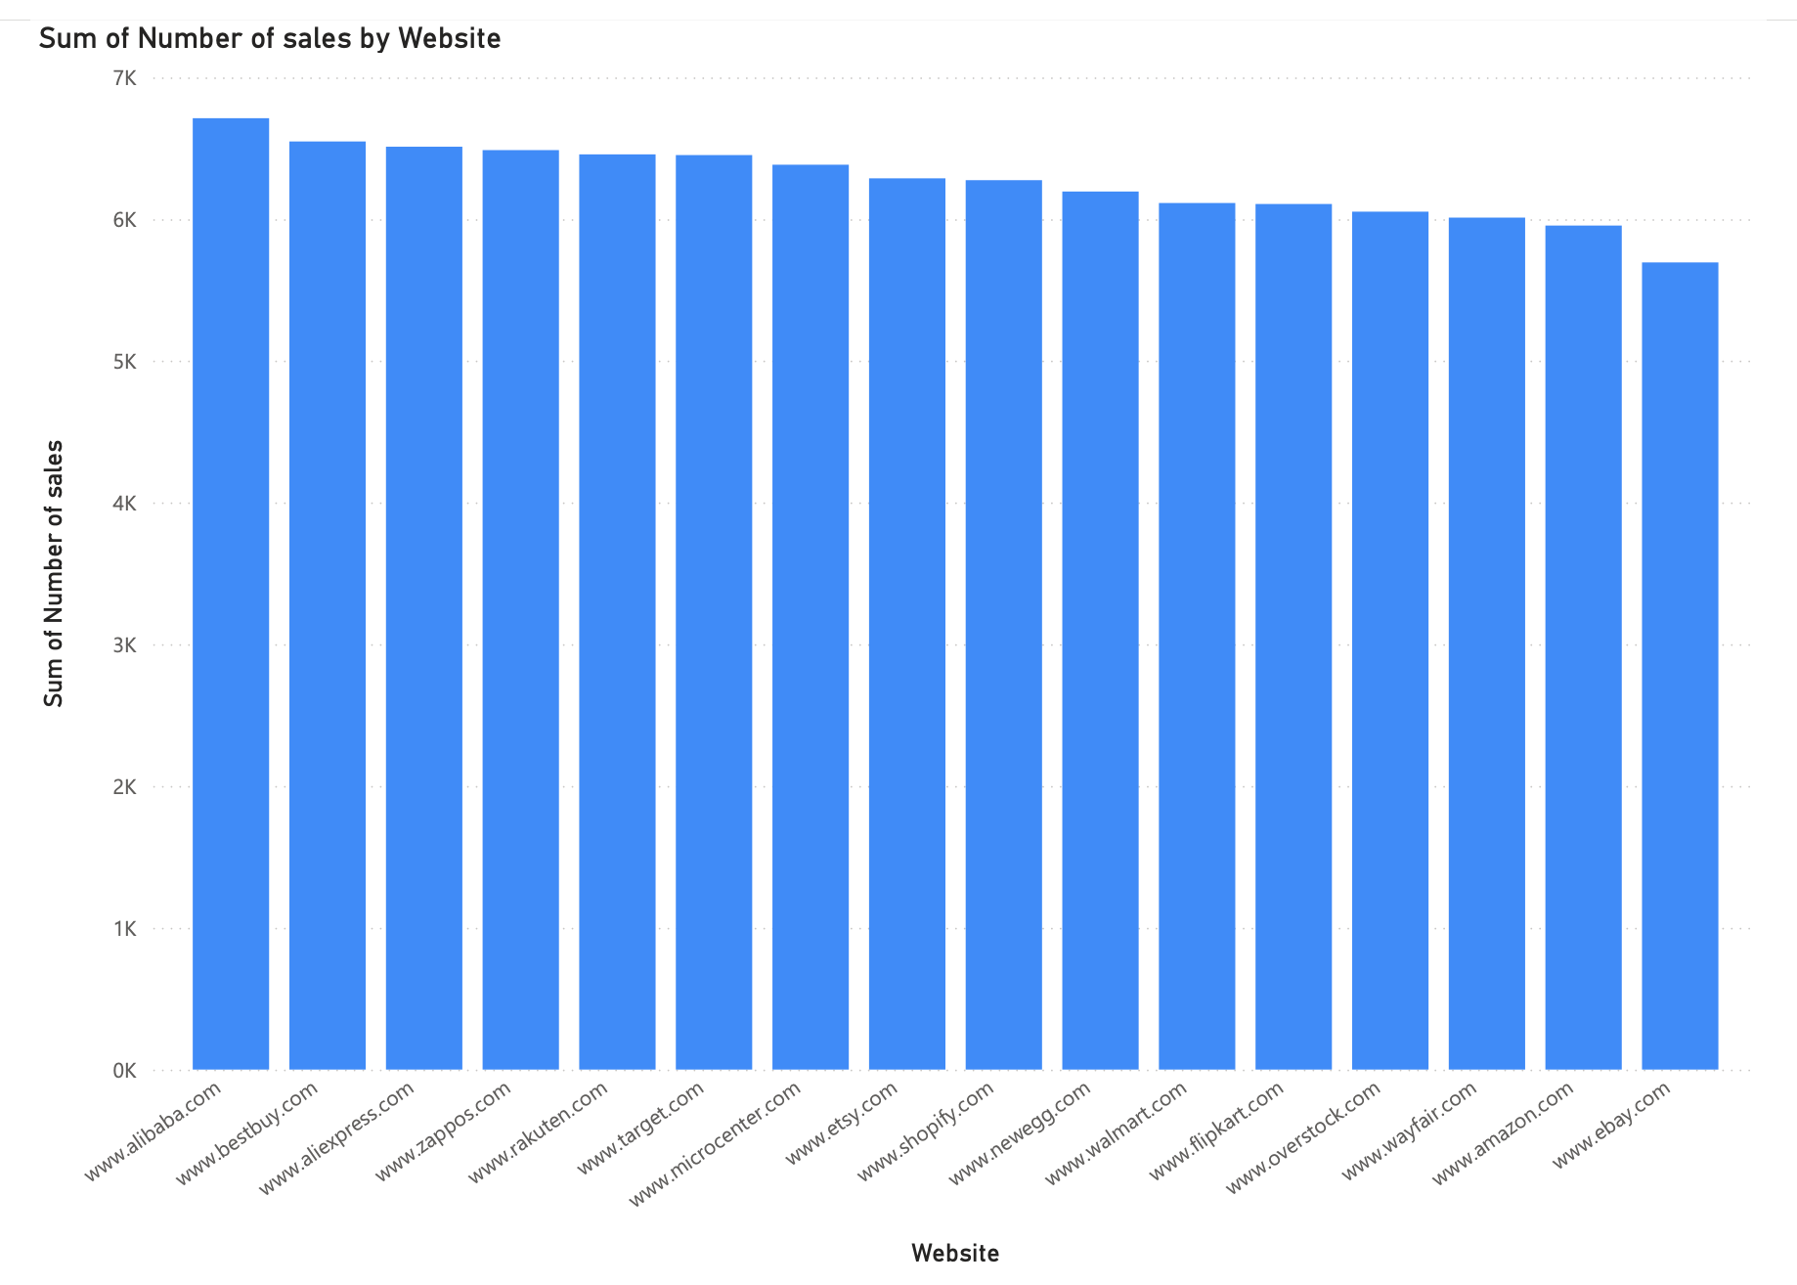
By website

Slide 8

Observations
Although it appears many cities in the west place orders, the total number of sales are much less in total when compared to the East/Southern countries. Using this insight more marketing tailored to high traffic cities in the west can be promoted to result in higher ticket item sales or multiple orders being made. Thus, increasing profit from already high occurring traffic.

